Slide 1
When Trauma Comes to Work

Slide 2
Building Trauma-Informed Workplaces
John D. Erickson, DMN
Dennis R. Humphrey, PhD
August 16, 2022
Eden Business Concepts, LLC
©️Eden Business Concepts LLC, 2022
Some material adapted from the 2021 One Mind at Work report: Trauma and Mental Health in the Workplace.

Slide 3
Foundational Perspective
We are most satisfied and effective in our work when the environment around us feels SAFE.

Slide 4
Fundamental reality
Your workplace can be a “safe” place for everyone

Slide 5
A “sAFE” Environment
Secure – not threatened
Acknowledged – not ignored
Free – not coerced
Empowered – not controlled

Slide 6
A “sAFE” Environment
Secure – support, empathy, trust
Acknowledged – attention and value
Free – learn, change, grow, speak
Empowered – able to decide and act

Slide 7
Driving Question
Do you recognize and care Well for those who are affected by trauma?

Slide 8
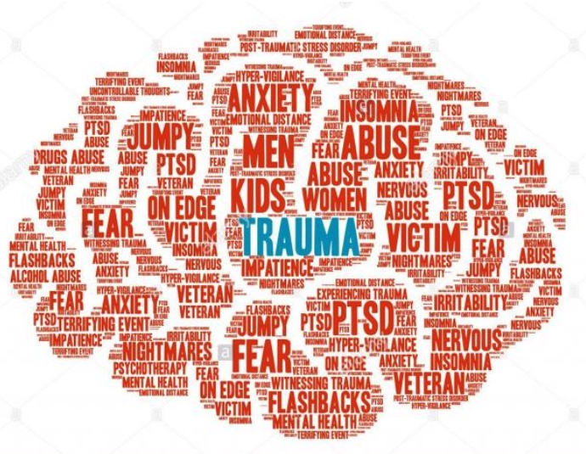
Our Brain on Trauma

Slide 9
What is “Trauma”?
An umbrella term for the mental, emotional, neurological, and physical response to an intensely distressing or disturbing event(s).
People who experience these events remain trapped in the past, constantly reliving the traumatic event through triggers and flashbacks.

Slide 10
Trauma is Real & Powerful
Affects more people than you realize (70%)
Affects workplace culture and environment
Affects costs, performance, and outcomes
Affects the care of employees
Affects the long-term direction of the company

Slide 11
Trauma IQ
Three types of Trauma:
Acute: a single event
Chronic: prolonged events
Complex: multiple events

Slide 12
Trauma IQ

Slide 13
Effects of Trauma
The slightest hint of a threat creates a fight-or-flight response, triggering stress hormones that keep them in a state of hyperarousal long after the perceived threat is gone.
Flashbacks keep survivors stuck in their traumatic event, so they are never able to fully engage in the present.
Trauma and flashbacks cause intense emotions and physical sensations that are overwhelming.

Slide 14
Effects of Trauma

Slide 15
What you observe
Depression, Moodiness
Anxiety, Fear, Indecision
Emotional outbursts, Drama
Isolation, Inattention, Lack of focus
Insomnia, Hypervigilance, Rage
Medicating: Alcohol, Drugs, Video . . . .

Slide 16
Crafting a response to trauma – proactive & preventative
Recognize causes and triggers of trauma
Create a strategic planning group on trauma
Practice traumatic event responses
Provide information sessions to normalize mental health discussion

Slide 17
Creating a Trauma-Resilient workplace
Build a Resilient Culture
Reduce Stigma
Create Empathetic Leadership
Notes:
Building a Resilient Culture:
- stress reduction & coping skills
- training in emotional intelligence and empathetic responses
- referrals: chaplains, mental health professionals, social workers
Reduce Stigma:
- safe environment
-information & discussion to normalize mental health
-promote help-seeking
Create Empathetic Leadership
- interpersonal skills
- recognize signs of distress
- become advocates for mental health
- promote authentic and vulnerable conversations

Slide 18
Managing a Crisis
People come first
Make choices available
Recovery through work
Overcome barriers to care

Slide 20
Trauma-informed workplaces are the future
80% of employers report that their “most consequential” action during the pandemic has been to consider the physical safety and emotion health of employees.

Slide 21
Fundamental reality
Your workplace can be a “safe” place for everyone

Slide 22
To Consider
Are you aware of the number of people around you affected by trauma?
How are you building a trauma-resilient workplace?
What is your plan for a mental health crisis at work?
What mental healthy resources have you made available for your workforce?

Slide 23
Resources
The Body Keeps the Score, Bessel Van Der Kolk
Trauma and Mental Health in the Workplace, One Mind at Work and the SHRM Foundation
Trauma At The Workplace, What To Do About It, Garen Staglin, Forbes, November 10, 2021

Slide 24
Building Trauma-Informed Workplaces
John D. Erickson, DMN
Dennis R. Humphrey, PhD
August 16, 2022
Eden Business Concepts, LLC
©️Eden Business Concepts LLC, 2022
Some material adapted from the 2021 One Mind at Work report: Trauma and Mental Health in the Workplace.

